Slide 1



Hospital Nutrition Management System: Allergies & Complex
Feeding Needs
Mishel Svirsky, Tomer Natan

Slide 2


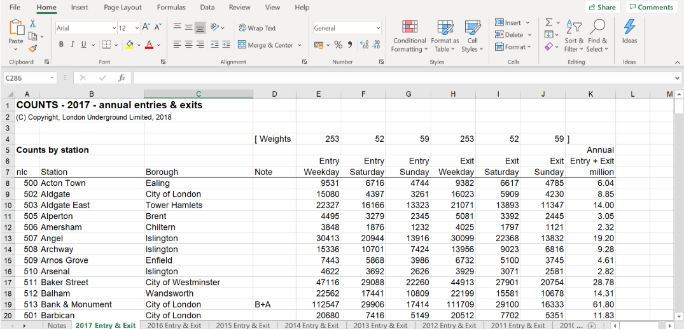
Current Hospital Workflow
All nutrition-related information is managed in a centralized Excel file.
Kitchen staff use the Excel file to check patient allergies during meal distribution
The same Excel file is shared and used by all relevant hospital staff.

Slide 3




Challenges and Motivation for Change
Confusing User Interface
Peak-Time Decision Pressure
The Excel interface can be confusing for kitchen staff during fast-paced work.
Working during peak hours with a complex Excel-based system is challenging and slows decision-making.
Limited Mobile Accessibility
Difficult Data Maintenance
The dietitian is dependent on the Excel file and lacks convenient mobile access.
As the number of products grows, the Excel file becomes harder to manage and maintain.

Slide 4


Literature Review
Research shows that nutrition-related errors in hospitals are common and can significantly impact patient safety[1].
Studies highlight that digital nutrition and allergy management systems reduce errors in meal preparation and delivery[1][2].
Existing research emphasizes that poor usability and complex interfaces limit the effectiveness of digital health systems[3].
The literature supports the need for a simple, reliable, and workflow-oriented system for hospital nutrition management !
[1] Davis Austria et al. (2024)
[2] Naisby et al. (2025)
[3] Mandracchia et al. (2020)

Slide 5


Existing Solutions and Market Gaps
Limitations | Strengths | Solution
High error risk, Manual work, Complex UI | Flexible, low cost | Excel (Manual)
Not designed for kitchen workflow, Complex UI | Clinical integration | EMR Systems (e.g., Chameleon)
Lacks clinical diet context | Modern UI, allergen automation | SaaS Tools (e.g., Nutritics)
Very expensive and complex | Comprehensive, safe | Enterprise Systems (e.g., CBORD)

Slide 6


Project Goal
• Design a simple and intuitive nutrition management system for hospitals.
• Support safe food selection based on allergies and feeding limitations.
• Improve decision-making for dietitians and kitchen staff during daily work.
• Enable dietitians to work in a more convenient and safer manner.

Slide 7


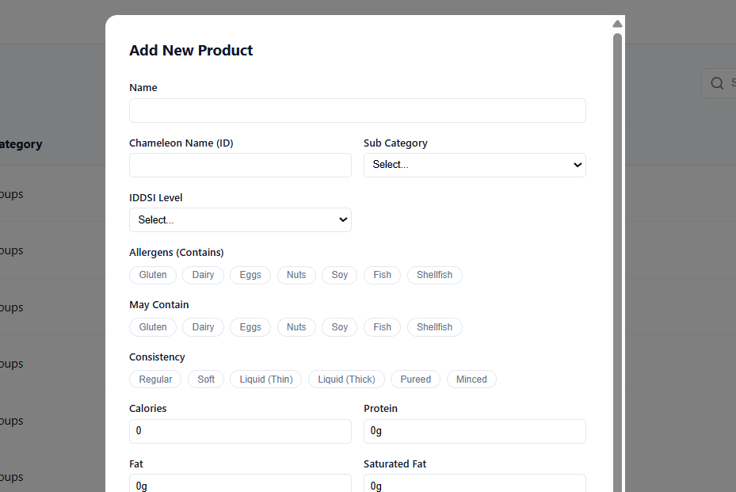
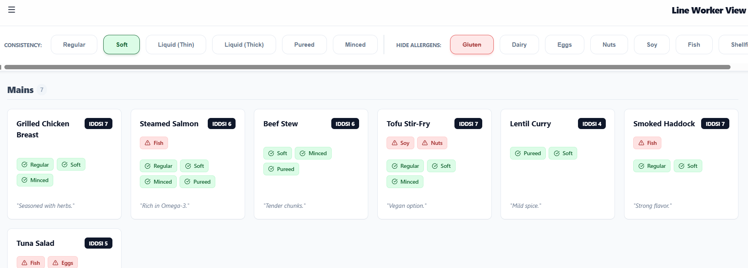
Functional Requirements
Catalog Maintenance Panel
The Dietitian must have access to a dedicated, user-friendly panel for adding, editing, and deleting all products, which directly replaces the old Excel maintenance process.
Quick Allergy/Restriction Filtering
  The system must provide a primary interface where the Line Worker selects allergies/restrictions (via clear buttons), and the product list is instantly filtered to show only safe items.

Slide 8
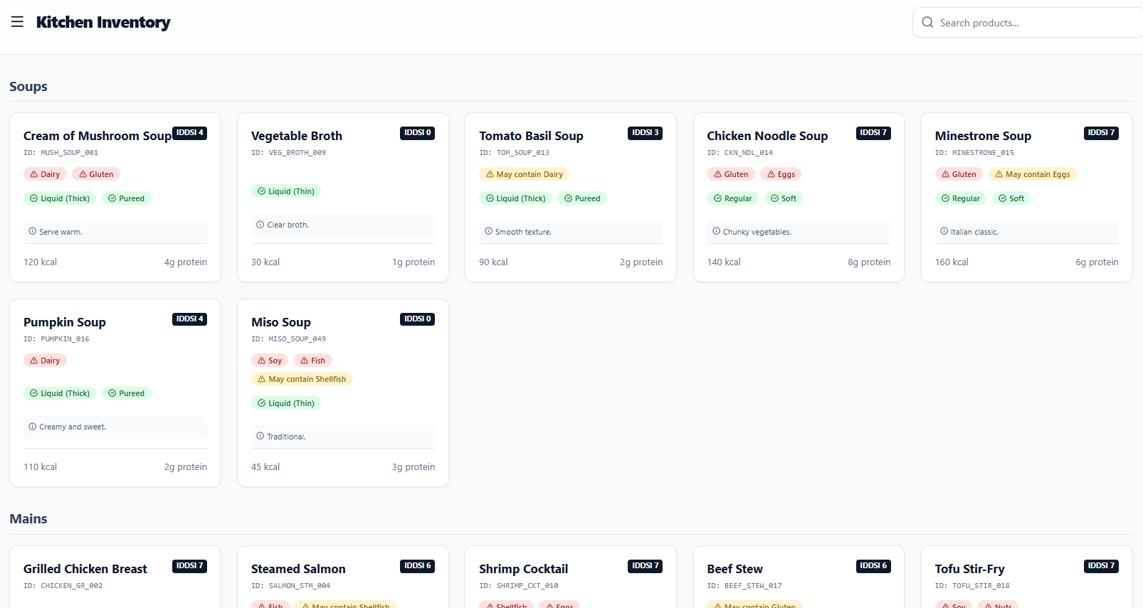
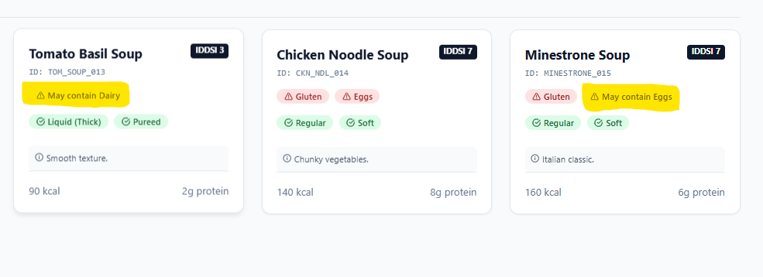
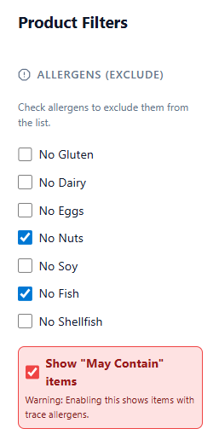
Functional Requirements
View Product Catalog
  The system must allow authorized users (Dietitians and Line Workers) to view the entire, up-to-date product catalog for reference.
"Contains" vs. "May Contain" Distinction and Filtering
  The data model and filtering interface must differentiate between products that Contain an allergen (always filtered out) and those that May Contain it (offering optional inclusion/exclusion based on risk tolerance).

Slide 9
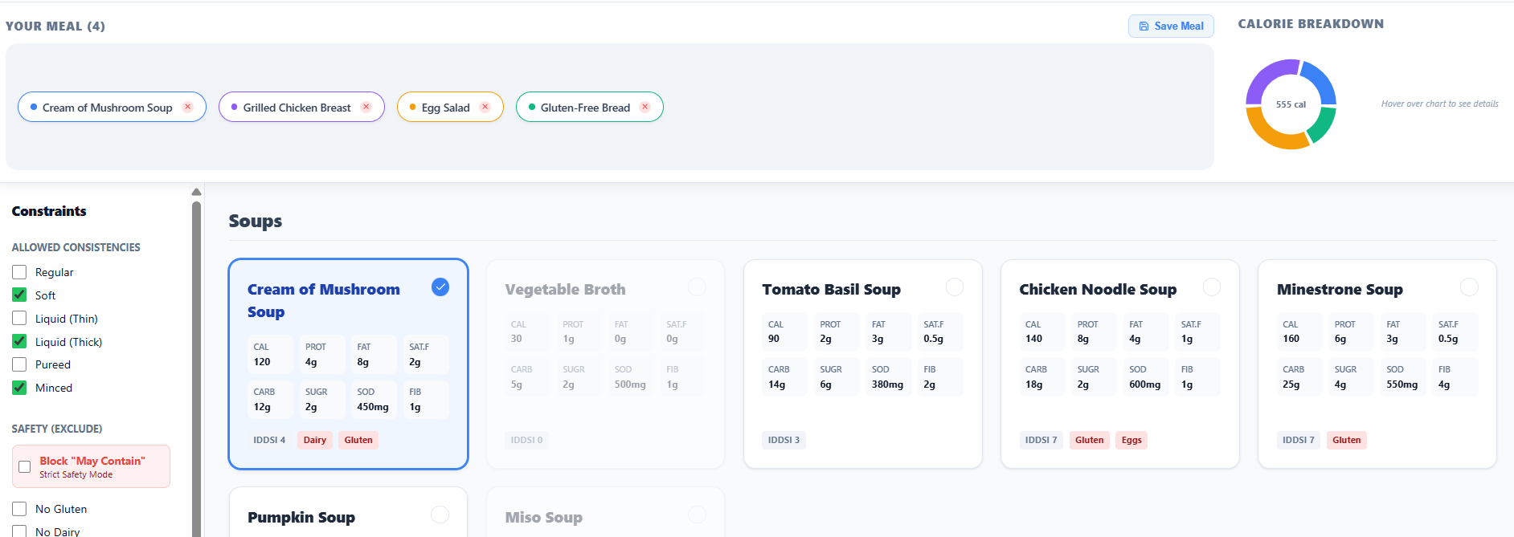
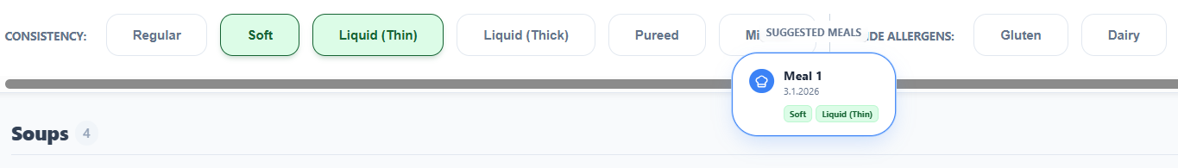
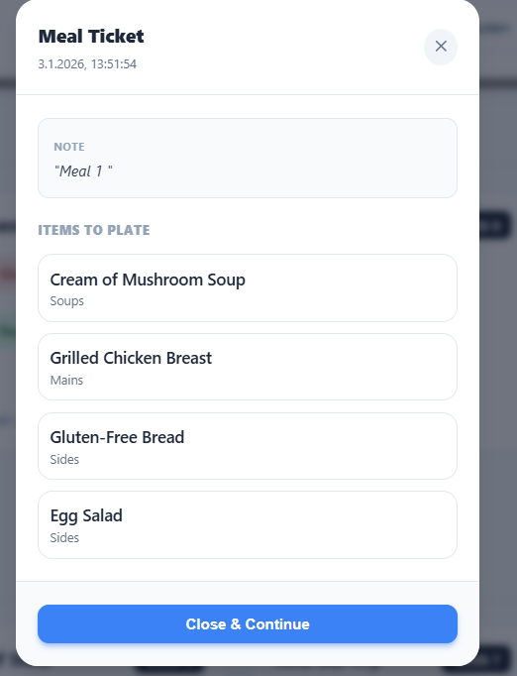
Functional Requirements
Menu Building Page for Patients
  The system should include a dedicated page allowing a Dietitian (or Line Worker) to assemble a final, confirmed meal list for a specific patient.
Menu Storage and Retrieval
  The system must enable saving a pre-prepared, filtered menu, linking it to the exact filtering criteria used, for easy recall.

Slide 10
Non-Functional Requirements
Dietitian Mobile Access
Query Response Time
  The entire user interface must be fully responsive and optimized for seamless use on the Dietitian's mobile device.
The time taken for any database query, including product filtering or menu retrieval, must be less than 2 seconds during active use on the line to ensure efficient workflow.
Authentication & Authorization:
Line Worker UI Accessibility
  User passwords must be securely stored (hashed/encrypted) in the database.
  Role-Based Access Control (RBAC) must be enforced: Line Workers receive Read-Only access; Dietitians receive Read/Write (editing) access.
The filtering screen must be designed with extreme simplicity, visual clarity, and large, clear controls to minimize errors by kitchen staff in a fast-paced environment.

Slide 11
Thank you !

